Slide 1

HEARTBRIDGE UNITING VOLUNTEERS WITH CAUSES
WOMEN BATTLES

Slide 2
INTRODUCTION
Millions of individuals yearn to give back, but finding the right cause feels like a maze, leaving potential untapped.
Nonprofits struggle to attract and manage volunteers, limiting their impact in tackling community need.
This "volunteer gap" hinders their potential for good. The disconnect creates a ripple effect: individuals can't contribute, communities lack support, and crucial progress stalls.
We need to connect the dots .We need a solution that bridges this gap, empowering individuals to contribute and enabling organizations to thrive.
Forget the maze – "HeartBridge" paves the way for seamless volunteer connections, unlocking the potential for positive change.

Slide 3
PROBLEM STATEMENT
Build a community-driven platform that connects volunteers with local nonprofit organizations, enabling them to find opportunities to donate their time, skills, or resources to meaningful causes. Implement features for event scheduling, donation tracking, and impact measurement.

Slide 4
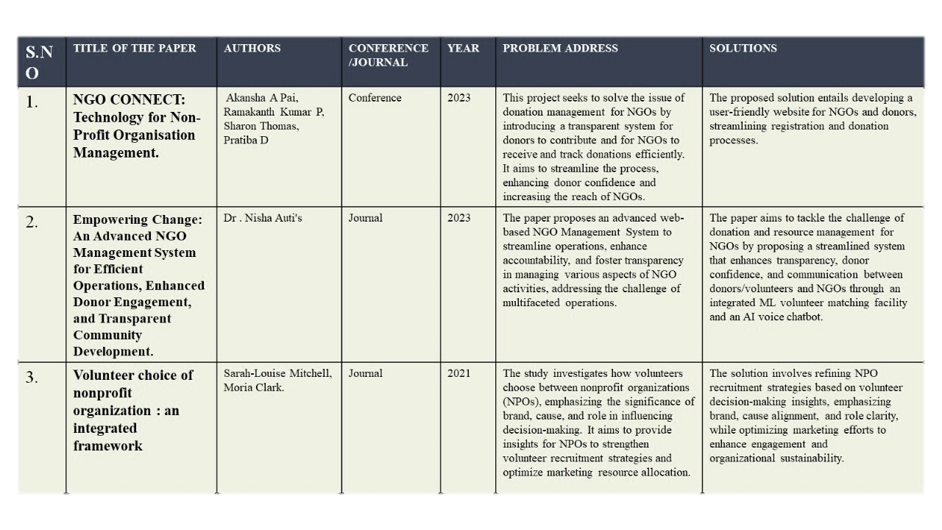
LITERATURE SURVEY
HELLO

Slide 5
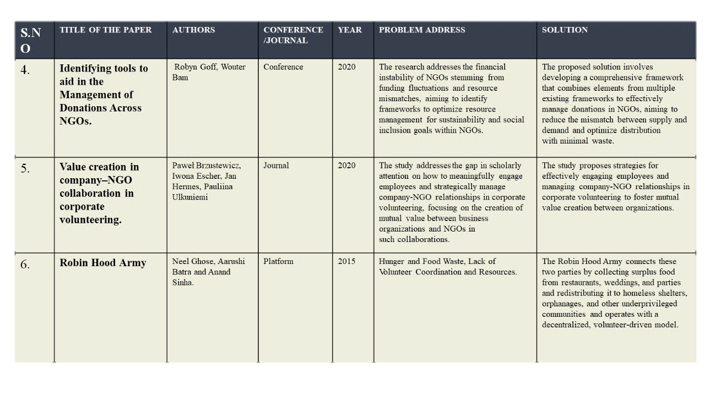
LITERATURE SURVEY
HELLO

Slide 6
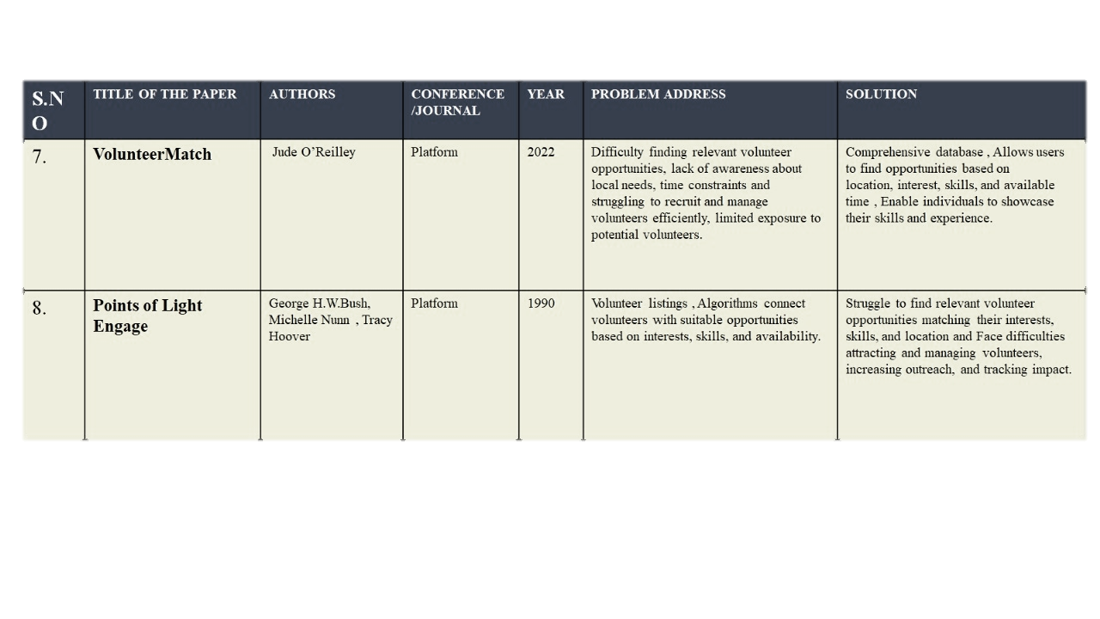
LITERATURE SURVEY
HELLO

Slide 7
PROPOSED SOLUTION
A community-driven platform called “HEARTBRIDGE” which bridges the gap between the volunteers and non-profit organizations.
Features in HeartBridge:
Volunteer and NGO Registration and login.
Dashboard creation and timely updation.
Past activities track of volunteer.
NGO’s suggestions based on the volunteer’s location.
Donation Tracking.
Event Scheduling using Calenders.
Impact Measurement using Testimonials.
Volunteer Credits Addition.
Review.

Slide 8
3-BOX ANALYSIS
PAST SYSTEM | EXSISTING SYSTEM | EXPECTED SYSTEM
Points of Light Engage: Volunteer listings , Algorithms connect volunteers with suitable opportunities based on interests, skills, and availability. | VolunteerMatch: --Vast networks and global reach. --Can overwhelm new users. --Matching might lack personalization. Idealist: --Offers global reach. --Potential for overwhelming new users. --Matching may not be sufficiently personalized. | Heartbridge aims to be different, offering a matching system, clear impact tracking, and a focus on UN goals like responsible consumption.

Slide 9
3-BOX ANALYSIS
PAST SYSTEM | EXISISTING SYSTEM | EXPECTED SYSTEM
CHALLENGES FACED: Struggle to find relevant volunteer opportunities matching their interests, skills, and location and Face difficulties attracting and managing volunteers, increasing outreach, and tracking impact. | HandsOn Connect: --Focuses on corporate volunteering. --Limits options for other types of volunteering. SkillShare: --Fosters skill development. --Might not cater to traditional volunteering needs. | By learning from past systems' strengths and weaknesses, Heartbridge strives to be a more personalized, impactful, and sustainable solution for connecting volunteers and building a brighter future. These strategies aim to improve volunteer engagement, community impact, and innovation for a brighter future.

Slide 10
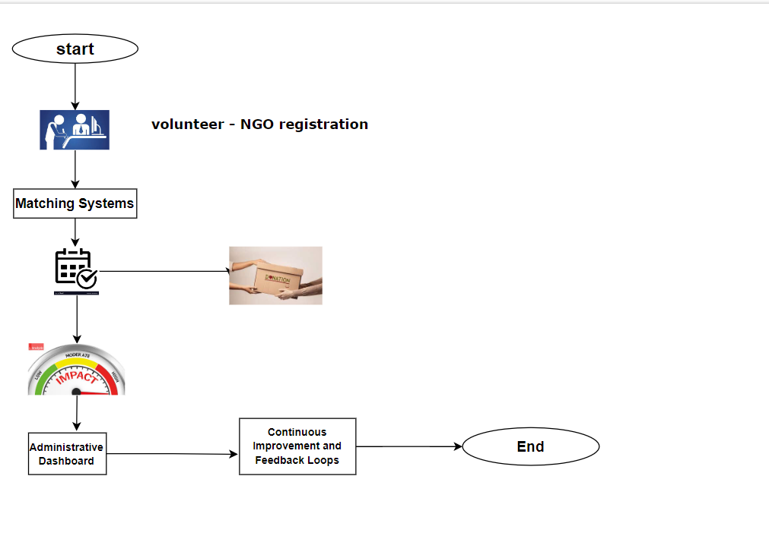
FLOWCHART

Slide 11
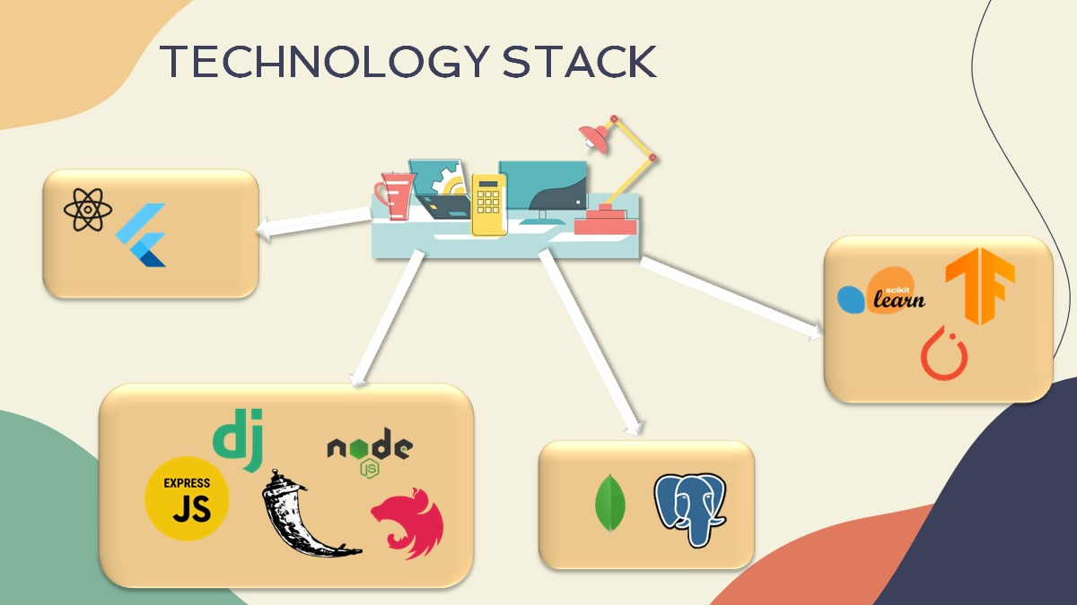

Slide 12
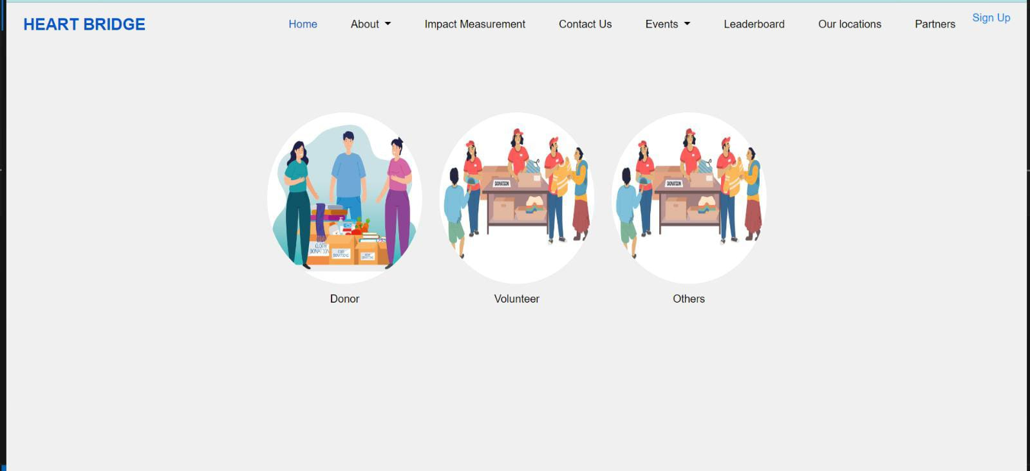
RESULT
Home:

Slide 13
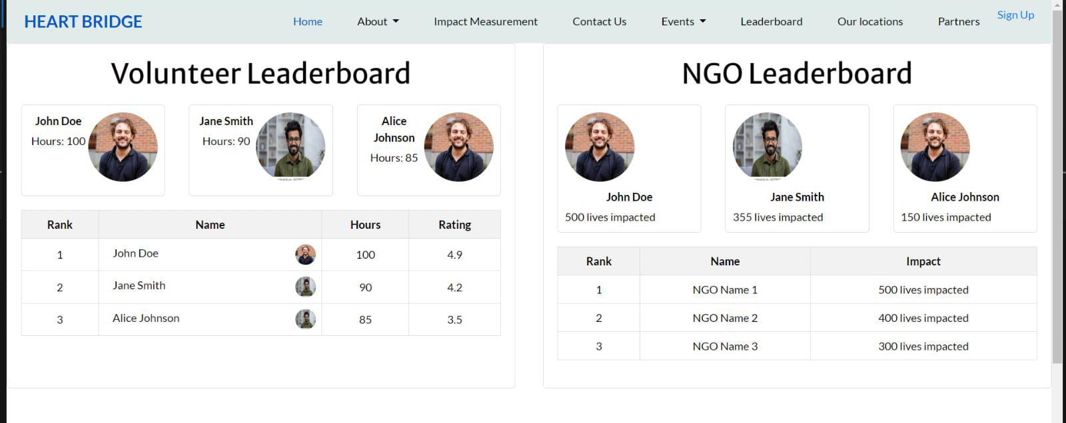
LeaderBoard:

Slide 14
FUTURE ENHANCEMENT:
connecting volunteers and organizations, continuous improvement fuels long-term impact.
Imagine empowering volunteers with AI-powered skills assessments, personalized learning pathways, and mentorship programs.
Hyperlocal impact reports and collaborative challenges can further amplify community engagement.
Integrating virtual volunteering opportunities, blockchain for secure tracking, and AI chatbots for support pushes innovation further.
By focusing on personalized skill development, enhanced community impact, and sustainable innovation, Heartbridge can evolve into an even more powerful force for positive change, bridging hearts and building a brighter future.

Slide 15
CONCLUSION:
Our platform serves as a dynamic nexus, seamlessly connecting volunteers and NGOs through a multifaceted array of features. By facilitating impact measurement, event scheduling, reviews, donation tracking, and comprehensive impact assessment tools, we empower both volunteers and NGOs to maximize their efforts and make a tangible difference in the world. With streamlined communication and robust functionality, our platform catalyzes meaningful change, fostering collaboration, transparency, and accountability within the global community. Join us in redefining volunteerism and NGO engagement, one connection at a time.

